Slide 1
Introduction to Programming
Part 3
Barb Ericson
Georgia Institute of Technology
May 2006

Slide 2
Learning Goals
Understand at a conceptual level
  Binary Numbers
    How to add binary numbers
    2’s compliment notation
    How to subtract a number from another
    How to represent floating point numbers in binary
  How many patterns do you have with n number of bits?
    Why does it matter?

Slide 3
Binary Numbers
We usually work with decimal numbers with digits from 0 to 9 and powers of 10
  7313 = (7 * 1000 + 3 * 100 + 1 * 10 + 3 * 1)
  Or (7 * 10³ + 3 * 10² + 1 * 10¹ + 3 * 10⁰)
The binary number system uses digits 0 and 1 and powers of 2
  0101 = (0 * 8 + 1 * 4 + 0 * 2 + 1 * 1)
  Or (0 * 2³ + 1 * 2² + 0 * 2¹ + 1 *2⁰)
  = 5
Notes:
See http://computer.howstuffworks.com/bytes1.htm for more information on number systems and binary numbers.

Slide 4
Binary Addition
To add two decimal numbers you add the digits and if the total is greater than ten you carry the one into the next column
To add two binary numbers
  0 + 0 = 0
  0 + 1 and 1 + 0 = 1
  1 + 1 = 0 with a carry of 1 into the next column to the left
00 10 111
01 01 001
---- --- ------
01 11 1000
00111001010
01010101101
-------------------
10001110111

Slide 5
2’s Compliment Notation
Computers actually only know how to add
  So, how do they handle subtraction?
Computers subtract by adding a negative number
How do you represent a negative number in memory?
  Positive numbers in 2’s compliment are just the same as a binary number
  For negative numbers reverse 0s and 1s and then add 1
    All negative numbers have a one for the leftmost bit
Notes:
See http://gs.fanshawec.ca/tlc/math270/1_7_Two's_Comp_Arith.htm and http://courses.cs.vt.edu/~csonline/NumberSystems/Lessons/SubtractionWithTwosComplement/Lesson.html for information on 2’s compliment

Slide 6
2’s Compliment Example
To subtract 3 from 7
First represent both as a binary number
  7 is 0000 0111 (1 + 2 + 4)
  3 is 0000 0011 (1 + 2)
Reverse the 0s and 1s and then add 1 to get -3
  0000 0011 reversed is 1111 1100
  add 1 0000 0001
  The result is 1111 1101
Notes:
In 2’s Compliment positive number are represented as regular binary numbers. Negative numbers will always have the leftmost bit as 1. Positive numbers will always have the leftmost bit as 0.

Slide 7
Add the Negative Number
To subtract 3 from 7
Add -3 to 7
  7 is 0000 0111
  -3 is 1111 1101
  The result is 1 0000 0100
Through away the leftmost 1
The answer is 0000 0100 which is 4

Slide 8
Patterns Exercise
How many different patterns of on and off bits are there in 3 bits? How many in 4 bits? How many in 8 bits?
000 is one pattern
001 is another pattern
010 is another pattern

Slide 9
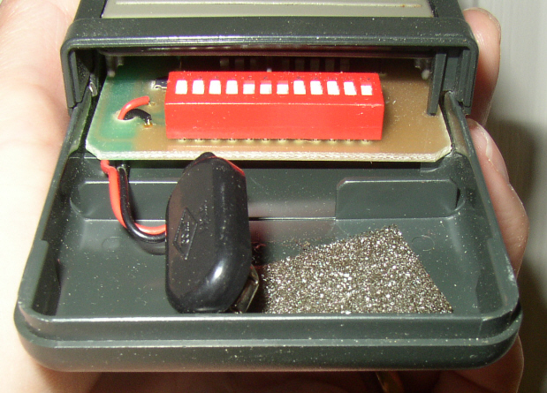
Does the number of patterns matter?
Some garage door openers in the 70s used 8 bits to set the code to use to open the door
  Giving 256 different patterns
  Which is enough that you won’t open your neighbors door
  But small enough that someone could try each one
Notes:
The picture shows a garage door opener from the 90s with 12 bits.

Slide 10
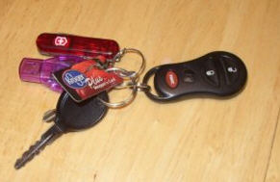
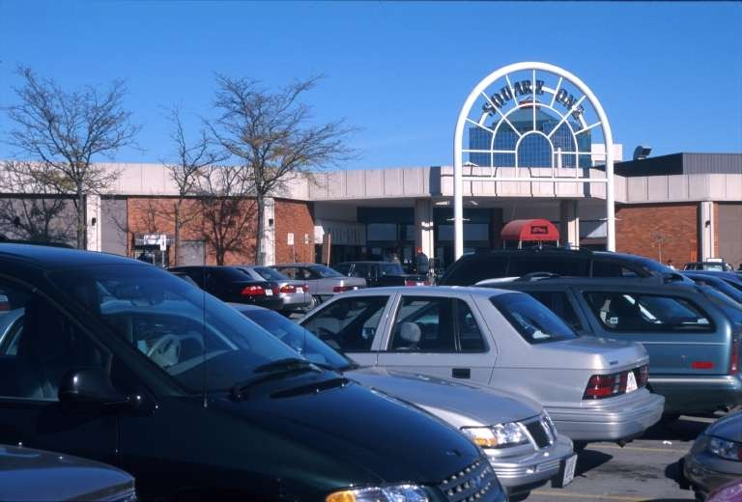
Remote Entry Systems
With 8 bits for a code you have a 1/256 chance of a random code working
  You don’t want someone opening your car in a place with lots of cars (like a mall)
There are also radio scanners that can capture your code
  So you want the code to change each time
Modern remote entry systems use a 40 bit rolling code
Notes:
See http://auto.howstuffworks.com/remote-entry2.htm for more information on remote entry systems.

Slide 11
Decimal Number Storage
How do you think a computer stores: 3205.406?
  It uses an IEEE 754 format
  Converts the number into a value between 0 and 1 raised to a power of 2
  Stores 3 things
    A bit for the sign
    A number between 0 and 1 (the mantissa)
    The power of 2 (the exponent)

Slide 12
Number of Bits Exercise
How many bits would you need to represent 64 values?
How many bits would you need to represent 256 values?
How many bits would you need to represent 1024 values?
How many bits would you need to represent 4096 values?
How many bits would you need to represent 1 million values?
Notes:
Go to www.dell.com or www.gateway.com as two places to order computers.

Slide 13
Summary
Numbers are stored using binary numbers
  Integers are stored in 2’s compliment
  Decimal numbers are stored in an IEEE format
Computers only know how to add
  They subtract by turning one number into a negative
    Using 2’s compliment
The number of values you can store in n bits is 2^{n}
  3 bits gives 2³ which is 2 * 2 * 2 or 8
  4 bits gives 2⁴ which is 2 * 2 * 2 * 2 or 16
  8 bits gives 2⁸ which is 256 values

